Slide 1

American International University - Bangladesh
Demonstrating Amplitude shift keying (ASK) of analog signal from binary bits and multiplexing (FDM) the analog signals to communicate as well as Demultiplexing the composite signal and convert them back into individual analog signals
Data Communication [E] Group - 8
SL | NAME | ID
1 | MD. TAHSIN HASIB | 22-46026-1
2 | MD. SHOHANUR RAHMAN SHOHAN | 22-46013-1
3 | KHUSHBU ALAM RAHI | 22-46947-1
4 | A. F. M. RAFIUL HASSAN | 22-47048-1
5 | MD. ASHIKUZZAMAN ABIR | 22-47006-1

Slide 2
Objectives
Amplitude Shift Keying (ASK)
Frequency Division Multiplexing
(FDM)
Demultiplexing

Slide 3
Amplitude Shift Keying (ASK)
Introduction to ASK: Amplitude Shift Keying (ASK) is a modulation technique where the amplitude of the carrier signal is varied in accordance with the digital data signal.
Uses two amplitude levels to represent binary data (0s and 1s).
For example, a higher amplitude represents a binary '1' and a lower (or zero) amplitude represents a binary ‘0’.
Equation:
ASK signal: 𝑠(𝑡)=𝐴(𝑡)⋅sin⁡(2𝜋𝑓𝑐𝑡)
Where A(t) represents the varying amplitude, and 𝑓𝑐 is the carrier frequency.

Slide 4
% digital bit stream x1 = [1 0 1 0 1 1]; x2 = [0 1 0 1 0 0]; x3 = [1 1 1 0 0 1]; bit1 = []; bp1 = 1; for n=1:1:length(x1) if x1(n) == 1; se = 3*ones(1,100); else x1(n) == 0; se = zeros(1,100); end bit1 = [bit1 se]; end tb1 = bp1/100:bp1/100:100*length(x1)*(bp1/100); figure subplot(3,1,1); plot(tb1, bit1,'lineWidth',2.5); grid on; axis([-0 6 -5 5]); ylabel('Amplitude(volt)'); xlabel('Time(sec)'); title('Digital Bit Stream Signal - 1'); | Am1 = 3; A = 0; brm1 = 1/bp1; fm1 = brm1*3; tm1 = bp1/99:bp1/99:bp1; ask1 = []; for i=1:1:length(x1) if (x1(i)==1) y = Am1*sin(2*pi*fm1*tm1); else y = A*sin(2*pi*fm1*tm1); end ask1 = [ask1 y]; end % plotting ask1 tmp1 = bp1/99:bp1/99:bp1*length(x1); subplot(3,1,2); plot(tmp1, ask1); axis([-0 6 -5 5]); xlabel('Time(sec)'); ylabel('Amplitude(volt)'); title('ASK of Digital Bit Stream Signal - 1'); | Ac1 = 3; brc1 = 1/bp1; fc1 = brc1*101; tc1 = bp1/99:bp1/99:bp1; c1=[]; for i=1:1:length(x1) if (x1(i)==1) y = Ac1*sin(2*pi*fc1*tc1); else y = Ac1*sin(2*pi*fc1*tc1); end c1 = [c1 y]; end tcp1 = bp1/99:bp1/99:bp1*length(x1); subplot(3,1,3); plot(tcp1, c1); axis([-0 6 -5 5]); xlabel('Time(sec)'); ylabel('Amplitude(volt)'); title('Carrier Signal for ASK - 1');

Slide 5
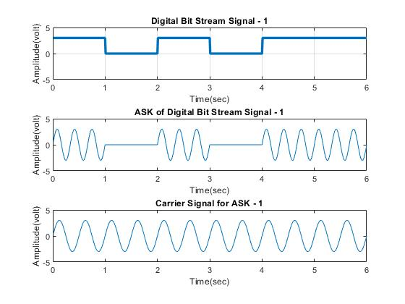

Slide 6
bit2 = []; bp2 = 1; for n=1:1:length(x2) if x2(n) == 1; se = 3*ones(1,100); else x2(n) == 0; se = zeros(1,100); end bit2 = [bit2 se]; end tb2 = bp2/100:bp2/100:100*length(x2)*(bp2/100); figure subplot(3,1,1); plot(tb2, bit2,'lineWidth',2.5); grid on; axis([-0 6 -5 5]);; xlabel('Time(sec)'); ylabel('Amplitude(volt)'); title('Digital Bit Stream Signal - 2'); | Am2 = 3; A = 0; brm2 = 1/bp2; fm2 = brm2*4; tm2 = bp2/99:bp2/99:bp2; ask2 = []; for i=1:1:length(x2) if (x2(i)==1) y = Am2*sin(2*pi*fm2*tm2); else y = A*sin(2*pi*fm2*tm2); end ask2 = [ask2 y]; end % plotting ask2 tmp2 = bp2/99:bp2/99:bp2*length(x2); subplot(3,1,2); plot(tmp2, ask2); axis([-0 6 -5 5]); xlabel('Time(sec)'); ylabel('Amplitude(volt)'); title('ASK of Digital Bit Stream Signal - 2'); | % carrier for ask2 Ac2 = 3; brc2 = 1/bp2; fc2 = brc2*105; tc2 = bp2/99:bp2/99:bp2; c2 = []; for i=1:1:length(x2) if (x2(i)==1) y = Ac2*sin(2*pi*fc2*tc2); else y = Ac2*sin(2*pi*fc2*tc2); end c2 = [c2 y]; end % plotting carrier for ask - 2 tcp2 = bp2/99:bp2/99:bp2*length(x2); subplot(3,1,3); plot(tcp2, c2); axis([-0 6 -5 5]); xlabel('Time(sec)'); ylabel('Amplitude(volt)'); title('Carrier Signal for ASK - 2');
Notes:
This MATLAB code appears to be a simulation of Amplitude Shift Keying (ASK) modulation for a digital bit stream signal. Let's break down the code step by step:
1. **Initialization**:
- `bit2`: An empty array initialized to store the digital signal.
- `bp2`: Bit period (time duration for one bit), set to 1.
2. **Digital Signal Generation**:
- A loop iterates over each bit `n` in the input signal `x2`.
- If the bit is 1, a signal `se` with amplitude 3 is generated, consisting of 100 samples.
- If the bit is 0, a signal `se` with amplitude 0 is generated, consisting of 100 samples.
- The generated signal `se` is concatenated to `bit2`.
3. **Time Vector Generation**:
- `tb2`: Time vector for plotting the digital signal, calculated based on the bit period and the length of the input signal.
4. **Plotting Digital Signal**:
- The subplot command is used to create a figure with three subplots.
- The first subplot plots the digital signal (`bit2`) against time (`tb2`).
5. **ASK Modulation**:
- Parameters like carrier amplitude (`Am2`), frequency (`fm2`), and time vector (`tm2`) are defined.
- Another loop iterates over each bit in the input signal `x2`.
- Depending on the value of the bit, a sinusoidal signal (`y`) is generated either with amplitude `Am2` or amplitude 0.
- The generated signal `y` is concatenated to `ask2`.
6. **Plotting ASK Signal**:
- The second subplot plots the ASK modulated signal (`ask2`) against time (`tmp2`).
7. **Carrier Signal Generation for ASK**:
- Parameters like carrier amplitude (`Ac2`), frequency (`fc2`), and time vector (`tc2`) are defined.
- Another loop iterates over each bit in the input signal `x2`.
- A carrier signal (`c2`) is generated with a fixed amplitude (`Ac2`) and frequency (`fc2`).
8. **Plotting Carrier Signal**:
- The third subplot plots the carrier signal (`c2`) against time (`tcp2`).
Overall, this code simulates the generation of a digital bit stream, its modulation using ASK, and the generation of the carrier signal. The subplots visualize the digital signal, the ASK modulated signal, and the carrier signal.

Slide 7
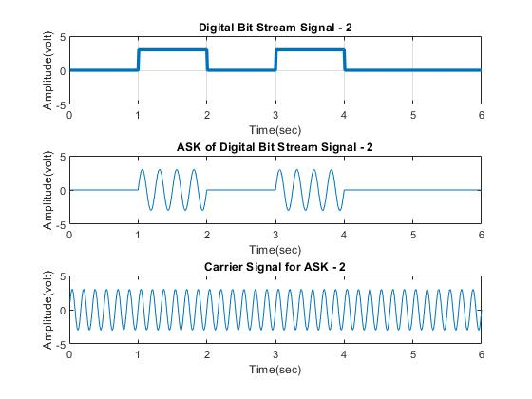

Slide 8
% third Signal bit3 = []; bp3 = 1; for n=1:1:length(x3) if x3(n) == 1; se = 3*ones(1,100); else x3(n) == 0; se = zeros(1,100); end bit3 = [bit3 se]; end tb3 = bp3/100:bp3/100:100*length(x1)*(bp3/100); figure subplot(3,1,1); plot(tb3, bit3,'lineWidth',2.5); grid on; axis([-0 6 -5 5]); xlabel('Time(sec)'); ylabel('Amplitude(volt)'); title('Digital Bit Stream Signal - 3'); | Am3 = 3; A = 0; brm3 = 1/bp3; fm3 = brm3*5; tm3 = bp3/99:bp3/99:bp3; ask3 = []; for i=1:1:length(x3) if (x3(i)==1) y = Am3*sin(2*pi*fm3*tm3); else y = A*sin(2*pi*fm3*tm3); end ask3 = [ask3 y]; end % plotting ask - 3 tmp3 = bp3/99:bp3/99:bp3*length(x3); subplot(3,1,2); plot(tmp3, ask3); axis([-0 6 -5 5]); xlabel('Time(sec)'); ylabel('Amplitude(volt)'); title('ASK of Digital Bit Stream Signal - 3'); | Ac3 = 3; brc3 = 1/bp3; fc3 = brc3*110; tc3 = bp3/99:bp3/99:bp3; c3 = []; for i=1:1:length(x3) if (x3(i)==1) y = Ac3*sin(2*pi*fc3*tc3); else y = Ac3*sin(2*pi*fc3*tc3); end c3 = [c3 y]; end % plotting carrier for ask - 3 tcp3 = bp3/99:bp3/99:bp3*length(x3); subplot(3,1,3); plot(tcp3, c3); axis([-0 6 -5 5]); xlabel('Time(sec)'); ylabel('Amplitude(volt)'); title('Carrier Signal for ASK - 3');

Slide 9
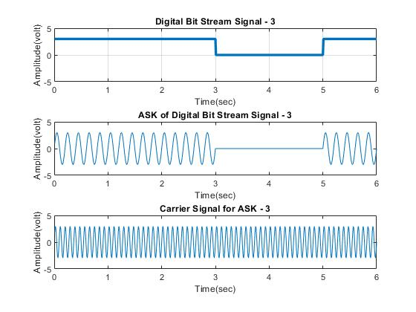

Slide 10
Frequency Domain of ASK1, ASK2, ASK3
% Fourier Transform of ask1 figure fs = 594; M_ask1 = abs(fftshift(fft(ask1)))/(fs/2); f_bit1 = fs/2*linspace(-1,1,fs); subplot(3,1,1) stem(f_bit1, M_ask1) axis([-270 270 0 2.5]) xlabel('Frequency (Hz)') ylabel('Amplitude') title('Frequency Domain - ASK of Digital Bit Stream Signal - 1') | % Fourier Transform of ask2 M_ask2 = abs(fftshift(fft(ask2)))/(fs/2); f_bit2 = fs/2*linspace(-1,1,fs); subplot(3,1,2) stem(f_bit2, M_ask2) axis([-270 270 0 2.5]) xlabel('Frequency (Hz)') ylabel('Amplitude') title('Frequency Domain - ASK of Digital Bit Stream Signal - 2') | % Fourier Transform of ask3 M_ask3 = abs(fftshift(fft(ask3)))/(fs/2); f_bit3 = fs/2*linspace(-1,1,fs); subplot(3,1,3) stem(f_bit3, M_ask3) axis([-270 270 0 2.5]) xlabel('Frequency (Hz)') ylabel('Amplitude') title('Frequency Domain - ASK of Digital Bit Stream Signal - 3')

Slide 11
Composite signal
Introduction to Composite Signal: A composite signal is a combination of two or more simple sine waves with different frequency, phase and amplitude.
Equation: Composite signal: comp(𝑡)=𝐴₁(𝑡)⋅sin⁡(2𝜋𝑓m₁𝑡) + 𝐴₂(𝑡)⋅sin⁡(2𝜋𝑓𝑐m₂𝑡) + 𝐴₃(𝑡)⋅sin⁡(2𝜋𝑓m₃𝑡)
Where A(t) represents the varying amplitude, and 𝑓𝑐 is the carrier frequency.

Slide 12
% plotting composite signal of ask1, ask2, ask3 tcomp = bp3/99:bp3/99:bp3*length(x3); comp_sig = (ask1).*c1+(ask2).*c2+(ask3).*c3; figure subplot(2,1,1) plot(tcomp, comp_sig); axis([0 6 -20 20]); xlabel('Time(sec)'); ylabel('Amplitude(volt)'); title('Composite Signal: ASK1 + ASK2 + ASK3'); | % Fourier Transform of composite signal M_comp = abs(fftshift(fft(comp_sig)))/(fs/2); f_bitcomp = fs/2*linspace(-1,1,fs); subplot(2,1,2) stem(f_bitcomp, M_comp) axis([-270 270 0 3.5]) xlabel('Frequency (Hz)') ylabel('Amplitude') title('Frequency Domain - Composite Signal (ASK1 + ASK2 + ASK3)')

Slide 13
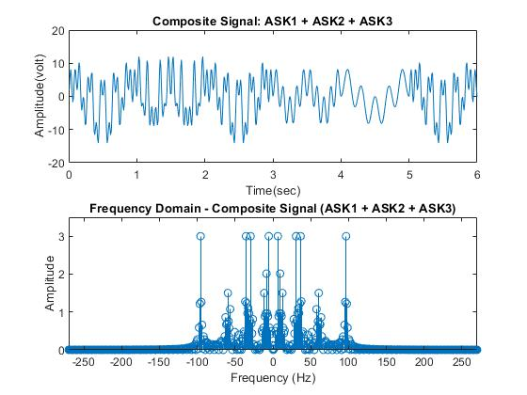

Slide 14
Demultiplexing
Demultiplexing process:
Demultiplexing process effectively recovers the original digital information from the modulated signals.
Passing the composite signal through bandpass filters
Received signal may differ from the original analog signal because of the noise that affected them while modulation

Slide 15
% demultiplexing the original analog ask1, ask2, ask3 signals fs = 300; %Sampling Frequency trec = bp3/99:bp3/99:bp3*length(x3); %Generating Time axis % Passing the Composite Signal Through Bandpass Filter % Normalize cutoff frequencies fc1_norm = (fc1 - fm1 - 6) / (fs/2); fh1_norm = (fc1 + fm1 + 6) / (fs/2); [num1, den1] = butter(5, [fc1_norm fh1_norm]); % Design filter for signal 1 fc2_norm = (fc2 - fm2 - 6) / (fs/2); fh2_norm = (fc2 + fm2 + 6) / (fs/2); [num2, den2] = butter(5, [fc2_norm fh2_norm]); % Design filter for signal 2 fc3_norm = (fc3 - fm3 - 6) / (fs/2); fh3_norm = (fc3 + fm3 + 6) / (fs/2); [num3, den3] = butter(5, [fc3_norm fh3_norm]); % Design filter for signal 3 | % Filter the composite signal (assuming comp_sig is defined) bpf1 = filter(num1, den1, comp_sig); bpf2 = filter(num2, den2, comp_sig); bpf3 = filter(num3, den3, comp_sig); % Demodulation (assuming Am1, Am2, Am3 are defined) z1 = 2*bpf1 .* c1; z2 = 2*bpf2 .* c2; z3 = 2*bpf3 .* c3; % Normalize cutoff frequencies for demodulation filters fm1_norm = (fm1 + 6) / (fs/2); [num5, den5] = butter(5, fm1_norm); Rec1 = filter(num5, den5, z1); fm2_norm = (fm2 + 6) / (fs/2); [num6, den6] = butter(5, fm2_norm); Rec2 = filter(num6, den6, z2); fm3_norm = (fm3 + 6) / (fs/2); [num7, den7] = butter(5, fm3_norm); Rec3 = filter(num7, den7, z3); | % Plotting the Received Signals in Time-Domain and Frequency Domain figure subplot(3,1,1) plot(trec, Rec1) xlabel('time') ylabel('amplitude') title('received signal 1 in time domain') subplot(3,1,2) plot(trec,Rec2) xlabel('time') ylabel('amplitude') title('received signal 2 in time domain') subplot(3,1,3) plot(trec,Rec3) xlabel('time') ylabel('amplitude') title('received signal 3 in time domain')

Slide 16
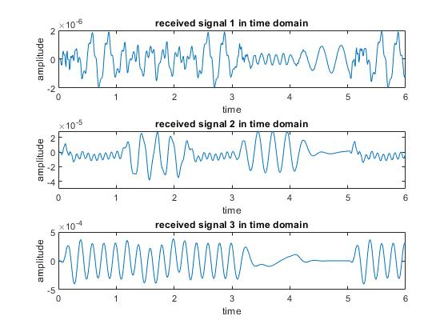

Slide 17
% Fourier Transform of rec1 figure fs = 594; M_rec1 = abs(fftshift(fft(Rec1)))/(fs/2); f_rec1 = fs/2*linspace(-1,1,fs); subplot(3,1,1) stem(f_bit1, M_rec1) xlabel('Frequency (Hz)') ylabel('Amplitude') title('Frequency Domain - Received ASK of Digital Bit Stream Signal - 1') | % Fourier Transform of rec2 M_rec2 = abs(fftshift(fft(Rec2)))/(fs/2); f_rec2 = fs/2*linspace(-1,1,fs); subplot(3,1,2) stem(f_rec2, M_rec2) xlabel('Frequency (Hz)') ylabel('Amplitude') title('Frequency Domain - Received ASK of Digital Bit Stream Signal - 2') | % Fourier Transform of ask3 M_rec3 = abs(fftshift(fft(Rec3)))/(fs/2); f_rec3 = fs/2*linspace(-1,1,fs); subplot(3,1,3) stem(f_rec3, M_rec3) xlabel('Frequency (Hz)') ylabel('Amplitude') title('Frequency Domain - Received ASK of Digital Bit Stream Signal - 3')

Slide 18
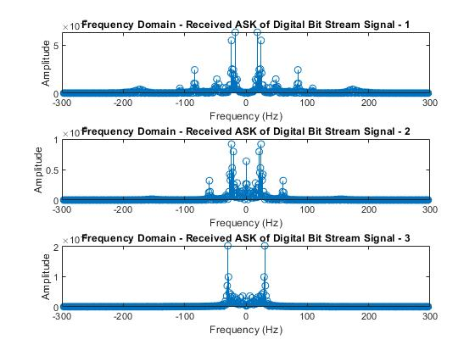

Slide 19
Impact of ASK and FDM on Society, Health, Safety & Culture:
Global Connectivity: Enable transmission of vast data volumes across various mediums, fostering growth of telecommunication networks. This revolutionizes communication, interaction, and business practices, promoting global connectedness.
Telemedicine: Facilitate transmission of medical data, enabling remote consultations, diagnoses, and medical advice for patients in remote areas.
Medical Monitoring: FDM is crucial for real-time monitoring of vital signs like blood pressure and heart rate, leading to improved health outcomes and patient care.
Emergency Communication: ASK and FDM are essential for emergency systems to transmit distress signals, location information, and critical data quickly and reliably during disasters or accidents, facilitating rescue operations.
Transportation Safety: FDM is used in aviation and maritime communication, ensuring secure and effective communication between control centers, vehicles, and personnel, enhancing operational efficiency and safety.
Cultural Exchange: Facilitate global distribution of diverse cultural content, promoting exchange and understanding between cultures.

Slide 20


